Slide 1
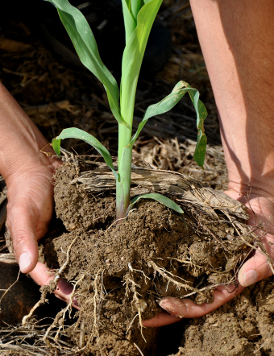
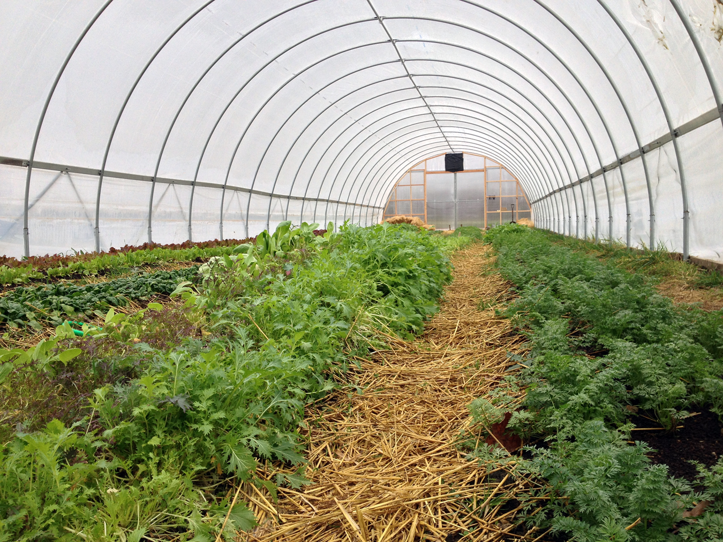



2026 Columbus Urban Agriculture Infrastructure Grant

Slide 2
Agenda
Intros
Background of Grant
Purpose and spirit of the grant
Eligibility
Application and Scoring/Grant Review
Questions and discussions

Slide 3

Intros
Annabel Spranger (Main grant contact)
Urban Conservation Program Coordinator - Franklin Soil and Water Conservation District
Maddie Motes
Conservation Program Assistant – Franklin Soil and Water Conservation District

Slide 4
Background/History of the Grant
This grant builds on the ongoing efforts to implement the Columbus and Franklin County Local Food Action Plan and was originally funded by the Franklin County Board of Commissioners, using ARPA funding
After ARPA funding was no longer available, FSWCD set out to find another source of funding to continue the Grant for a 3rd year
This years Grant is funded through City of Columbus, Councilmember Wyche’s Office
The stories we tell with this grant and the change we make will help us advocate for funding.
Notes:
Brian

Slide 5
Purpose and Spirit of the Grant
This grant aims to
  Strengthen local food supply chain
  Increase food crop production, processing, and distribution via sale/donation by local urban farms
  Accelerate the ability of local growers to scale up their operations
  Ensure support for socially disadvantaged farmers (e.g. BIPOC, women, and low-income growers)
  Foster community and collaboration between growers
This grant is primarily for critical infrastructure (water connection, cold storage, high tunnels, etc.)
This grant makes available $71,000 for local growers, with each organization able to apply for up to $10,000
Awarded grantees will be provided technical support throughout their project from OSU Extension, Natural Resources Conservation Service, and Franklin Soil and Water Conservation District

Slide 6
Purpose and Spirit of the Grant
This grant is primarily for critical infrastructure (water connection, cold storage, high tunnels, etc.)
New this year – you can also apply for some non-infrastructure related costs such as business development funds
This grant makes available $71,000 for local growers, with each organization able to apply for up to $10,000
Awarded grantees will be provided technical support throughout their project from OSU Extension, Natural Resources Conservation Service, and Franklin Soil and Water Conservation District

Slide 7
Eligibility
Small for-profit or non-profit urban farms, community gardens, and other organizations within City of Columbus (New for 2026)
Growing operation must be five (5) acres or smaller, with additional consideration given to operations under one (1) acre
One application may be submitted per organization. Multiple organizations can collaborate on one application/project.
Eligible uses are any sort of critical infrastructure that will help the farm or garden scale up their production or increase operational efficiency
This year, you may also apply for some non-infrastructure related costs – business development costs such as marketing, certifications, etc.
You may apply for up to $10,000 for your organization

Slide 8
Application
Application will be filled out online via Survey123
The application is extensive. Questions will be posted online in a PDF, and the landing page of the application will include a list of questions
Your responses will be saved within your browser (via cookies), so feel free to exit the site and come back to it
We will ask for a State of Ohio business license, proof of 501(c)(3), or proof of fiscal sponsor
If you lease your land, you will need to provide a letter from the landowner confirming you have permission to complete the requested project

Slide 9
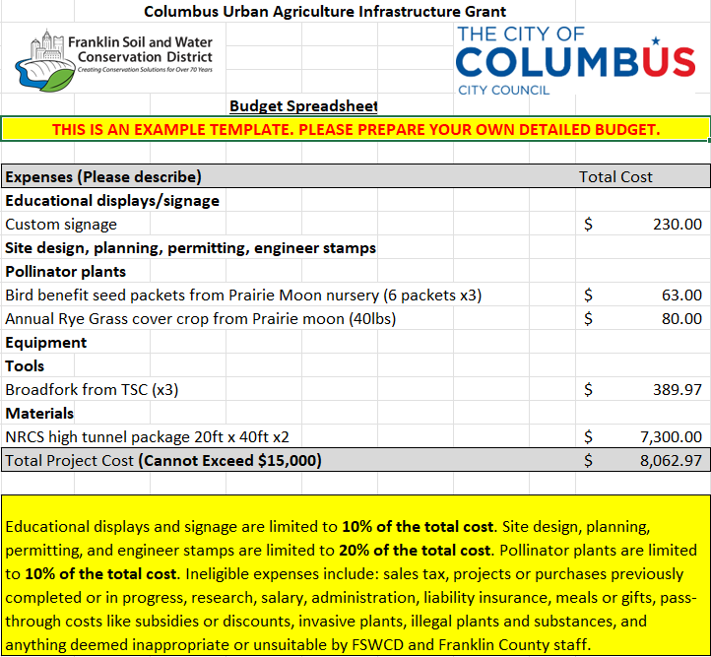
Application - Budget
PLEASE DOUBLE CHECK ALL FORMULAS TO ENSURE YOUR NUMBERS ARE ADDING UP CORRECTLY.
Applications should include “a well-thought out, detailed, and accurate budget, ensuring effective use of funds.” We will consider this when scoring applications.
This budget is just an example. Please do your research, get quotes, and be detailed.

Slide 10
Scoring and Grant Review
The grant application will OPEN September 1st, 2026 and CLOSE September 15th, 2026. Anticipate awards on September 29th, 2026.
Grants will be reviewed by a grant advisory committee, including individuals from OSU Extension, FSWCD, Franklin County, Franklin Park Conservatory, and City of Columbus.
A scoring rubric has been made available on the grant website (https://www.franklinswcd.org/urban-ag-grant)
Applications must be complete, well thought-out, provide all required documents, and provide answers to all questions asked
Project must be completed by mid-August 2027

Slide 11
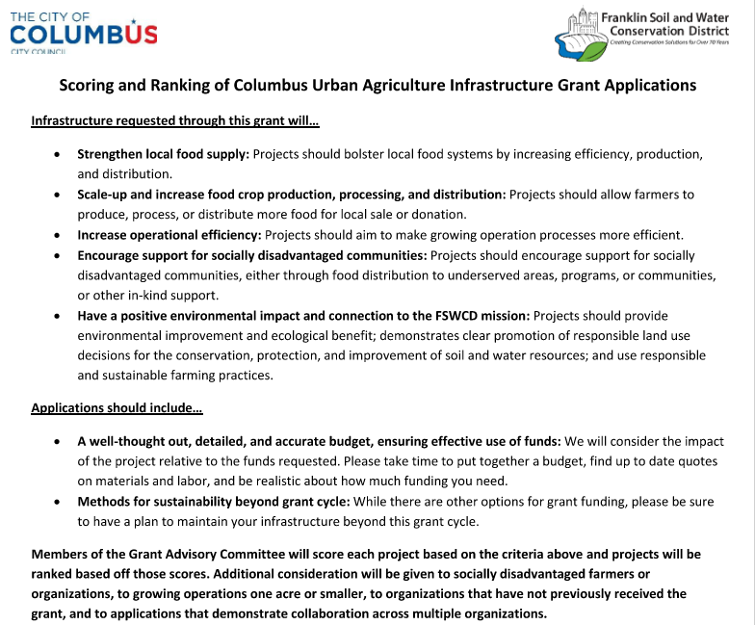
Scoring and Grant Review

Slide 12
Questions and Discussion
If we don’t have immediate answers to your questions, we will take note of them and follow up!
All questions asked via email, phone call, or in this meeting will be compiled into a document and posted on our website. We already have a FAQ document on the website, and it will be updated with questions asked in this info-session.
If you have a question, there is likely someone else who has it too – don’t be afraid to speak up!
If a question comes up later, please call the office, fill out a contact form on our website, or review our FAQs documents.

Slide 13
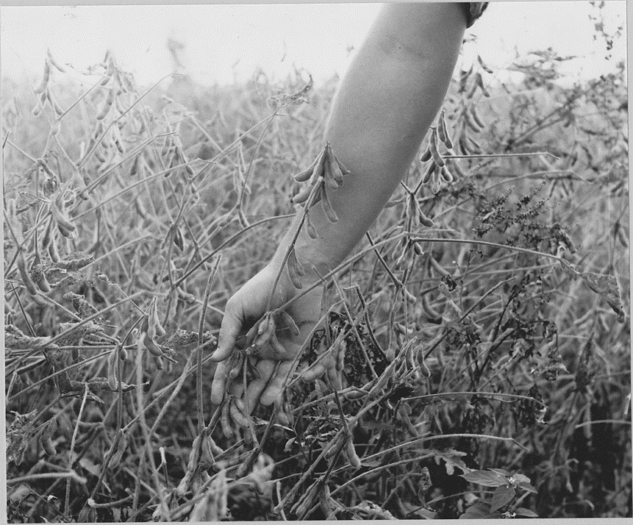
Thank you!
Annabel Spranger, Urban Conservation Program Coordinator
Email: aspranger@franklinswcd.org
Phone: 614-653-5815
Maddie Motes, Conservation Program Assistant
Email: mmotes@franklinswcd.org
Phone: 614-486-9613
Contact Form: https://customerassistance.franklinswcd.org/
Please visit https://www.franklinswcd.org/urban-ag-grant for more information and for all documents discussed tonight. A recording of this info-session and these slides will be posted publicly for you to go back to as you complete your application.

